Slide 1

SSD tehnologija
Matej Moškon
Notes:
1

Slide 2
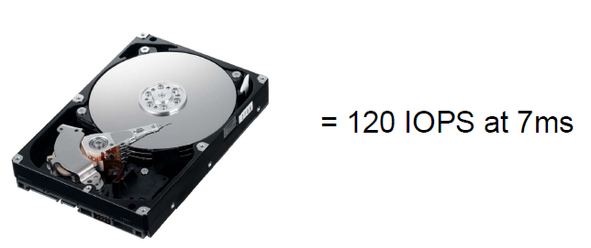

Performance vs kapacitete
Notes:
2

Slide 3
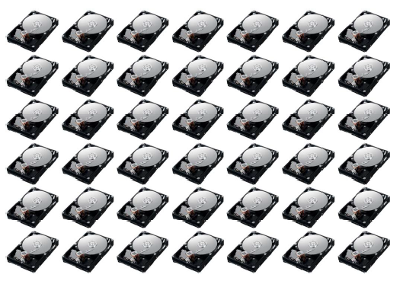
Performance vs kapacitete
1TB Database z zahtevo 5000 IOPS = 42 diskov
Notes:
3

Slide 4
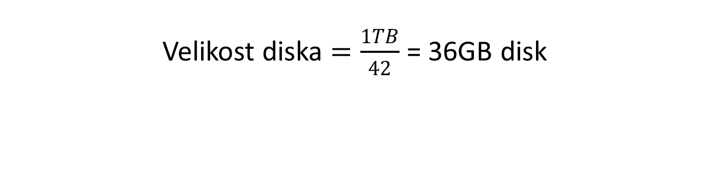
Performance vs kapacitete
Velikost diska $=\frac{1TB}{42}$ = 36GB disk
Velikost diska | Razpoložljiva kapaciteta | Višek kapacitete | Višek v %
600GB SAS | 25,2 TB | 24,2 TB | 2420%
900GB SAS | 37,8 TB | 36,8 TB | 3680%
1200GB SAS | 50,4 TB | 49,4 TB | 4940%
Notes:
4

Slide 5
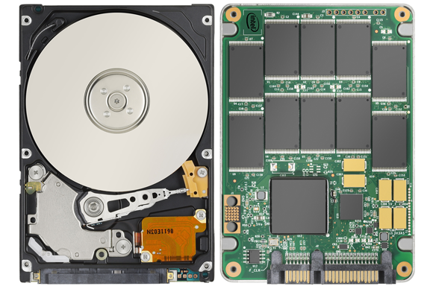
HDD vs SSD
Notes:
5

Slide 6
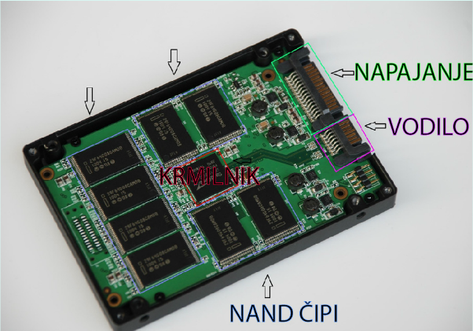
Kaj je SSD?
Notes:
6

Slide 7
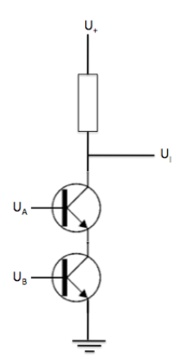
NAND operacija
A | B | I
0 | 0 | 1
0 | 1 | 1
1 | 0 | 1
1 | 1 | 0
Notes:
7
Tranzistorja prevajata le takrat, ko je na obeh podatek (U_{A} in U_{B}) 1 (visoka napetost). V tem primeru je na izhodu (U_{I}) nizka napetost (0). Če pa kateri ali oba od tranzistorjev ne prevajata, potem bo na izhodu največja napetost (1).

Slide 8
MLC vs SLC
Multi-Level Cell
  Tranzistor hrani več ravni naboja
  Hrani lahko več bitov podatkov
Single-Level Cell
  Ena raven (0 ali 1)
  Bolj zanesljivi
  Preprosti
  Zdržijo dlje
Notes:
8

Slide 9
TRIM in Wear-leveling mehanizmi
TRIM je operacija, ki sporoči SSD disku, kateri bloki niso več veljavni in jih lahko zbriše
  Tranzistor hrani več ravni naboja
  Hrani lahko več bitov podatkov
Wear-leveling mehanizem zagotavlja enakomerno obrabo blokov SSD diska
  Dinamična izravnava – rewrite operacije na nove bloke
  Statična izravnava – nespremenjeni bloki se periodično prepisujejo
 | Statična izravnava | Dinamična izravnava
Vzdržljivost | Daljša življenska doba | Krajša življenska doba
Performanse | Hitrejši | Počasnejši
Kompleksnost | Visoka stopnja | Manjša stopnja
Upraba | SSD | USB Flash
Notes:
9
No wear leveling
A Flash memory storage system with no wear leveling will not last very long if it is writing data to the flash. Without wear leveling, the Flash controller must permanently assign the logical addresses from the Operating System (OS) to the physical addresses of the Flash memory. This means that every write to a previously written block must first be read, erased, modified, and re-written to the same location. This is very time consuming and highly written locations will wear out quickly with other locations even being completely unused. Once a few blocks reach their end of life the drive is no longer operable.^{[2]}
Dynamic wear leveling
The first type of wear leveling is called dynamic wear leveling and it uses a map to link Logical Block Addresses (LBAs) from the OS to the physical Flash memory. Each time the OS writes replacement data, the map is updated so the original physical block is marked as invalid data, and a new block is linked to that map entry. Each time a block of data is re-written to the Flash memory it is written to a new location. However, blocks that never get replacement data sit with no additional wear on the Flash memory. The name comes from only the dynamic data being recycled. The drive may last longer than one with no wear leveling, but there are blocks still remaining as active that will go unused when the drive is no longer operable.^{[2][3]}
Static wear leveling
The other type of wear leveling is called static wear leveling which also uses a map to link the LBA to physical memory addresses. Static wear leveling works the same as dynamic wear leveling except the static blocks that do not change are periodically moved so that these low usage cells are able to be used by other data. This rotational effect enables an SSD to operate until most of the blocks are near their end of life.^{[2][3]} This is also sometimes referred to as global wear leveling, as the entire image is leveled.^{[citation needed]}
Comparison
The following table compares static and dynamic wear leveling:^{[3]}
Item
Static
Dynamic
Endurance
Longer life expectancy
Shorter life expectancy
Performance
Slower
Faster
Design Complexity
More complex
Less complex
Typical Use
SSDs^{[2]}
USB Flash Drives

Slide 10
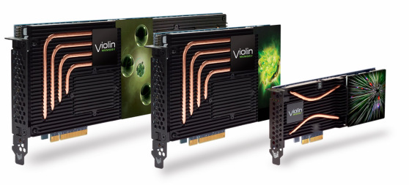
Flash diskovje
MLC/SLC uporaba neposredno preko sistemskega vodila
Hitrejši dostop do podatkov
Notes:
10

Slide 11
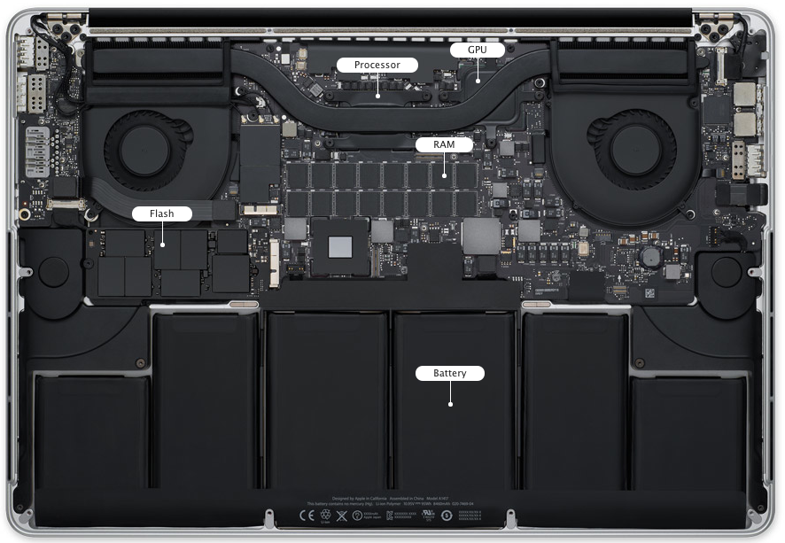
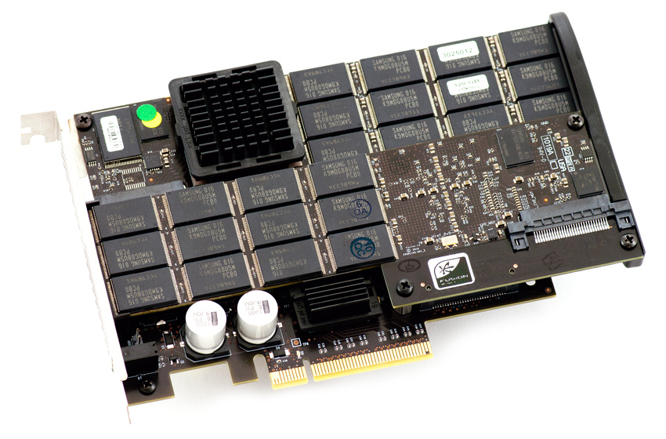
Flash vs SSD
Notes:
11

Slide 12
Prihodnost Flash tehnologij
 | 2013 | 2014 | 2015 | 2016 | 2017
Fast $$$ | eMLC SSD 24nm | eMLC SSD 16-19nm | eMLC SSD 10-14nm | 3D BiCS? | PCM SSD? 3D ReRAM?
Medium $$ | 15K RPM SAS (146GB)
 | 10K RPM (300-900GB) | 10K RPM
Slow $ | 7.2K RPM (3TB) | 7.2K RPM (4TB) | 7.2K RPM (6TB) | 7.2K RPM (8TB) | 7.2K RPM (10TB)
Notes:
12

Slide 13
NetApp v Flash okusu
SSD diskovne police
Virtual Storage Tiereing
  Flash Pool
  Flash Cache
  Flash Accel
All Flash Array
  EF540 / EF550
  Flash Ray
Notes:
13

Slide 14
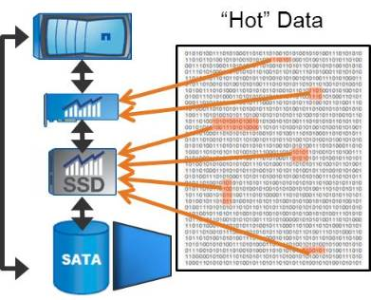
Flash Pool
Predpomnenje zapisovanja in branja (16k random rewrite)
Hibridni agregati
  SAS + SSD
  SATA + SSD
Notes:
14

Slide 15
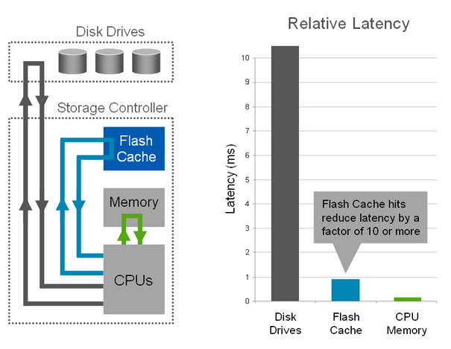
Flash Cache
Predpomnenje branja (16k random rewrite)
Različne kapacitete
Simulacija (PCS)
Notes:
15

Slide 16
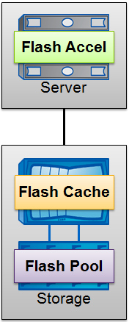
Flash Accel
Predpomnenje branja na strežniku
„Snap aware“
Mešana uporaba NetApp Flash tehnologij
Brezplačna licenca FlashAccel
Široka podpora Flash proizvajalcev
  SSD diski (Hitachi, Seagate, Toshiba, WD)
  Fusion-IO
  LSI WarpDrive
  Nytro WarpDrive
  Micron
Notes:
16

Slide 17

SSD diskovne police
Kapacitete
  SLC: 200GB, 400GB
Virtual Storage Tiereing
  Flash Pool
  Flash Cache
All Flash Array
  EF540 / EF550
  Flash Ray
Notes:
17

Slide 18
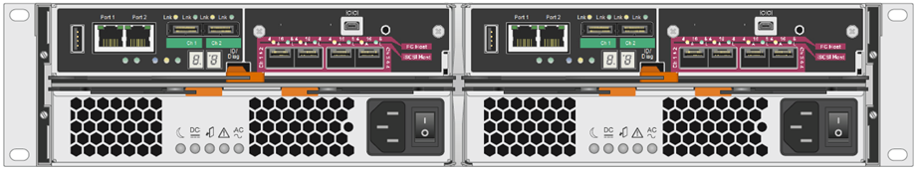
NetApp EF540 / EF550
Podvojen krmilnik
2,5“ 800GB SSD diski (max. 120 diskov)
10Gbit Ethernet, 8/16Gbit FC, 40Gbit Ini
FC (8/16Gbit), iSCSI (10Gbit), Inifiniband (40Gbit), SAS (6Gbit)
Notes:
18

Slide 19
Zmogljivost
 | EF540 | EF550
Burst I/O rate – cache reads (512B) | 800,000 IOPS | 900,000 IOPS
Sustained I/O rate – random disk reads (4K) | 300,000 to 330,000 IOPS | 400,000 to 450,000 IOPS
Sustained I/O rate – random disk writes (4K) | 65,000 IOPS | 75,000 IOPS
Sustained throughput – sequential disk reads (512K) | 6 GB/s | 12 GB/s
Sustained throughput – sequential disk write (CMD 512K) | 4 GB/s | 10 GB/s
Sustained throughput – sequential disk write (CME 512K) | 3 GB/s | 6 GB/s
Notes:
19

Slide 20
Random Reads
Notes:
20

Slide 21
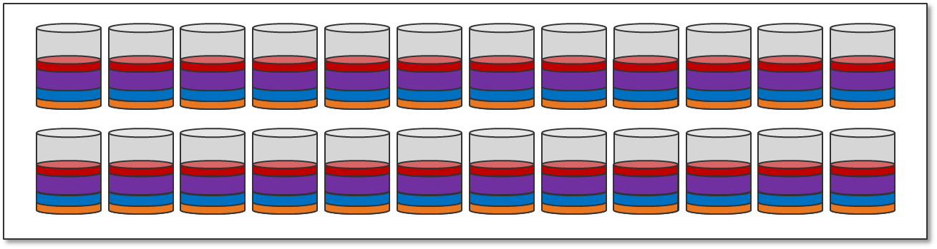
DDP – Dynamic Disk Pool
Distribuirani podatki po vseh diskih
Brez namenskega Hot Spare diska
Učinkovito širjenje obstoječih diskovnih skupin
Notes:
21

Slide 22
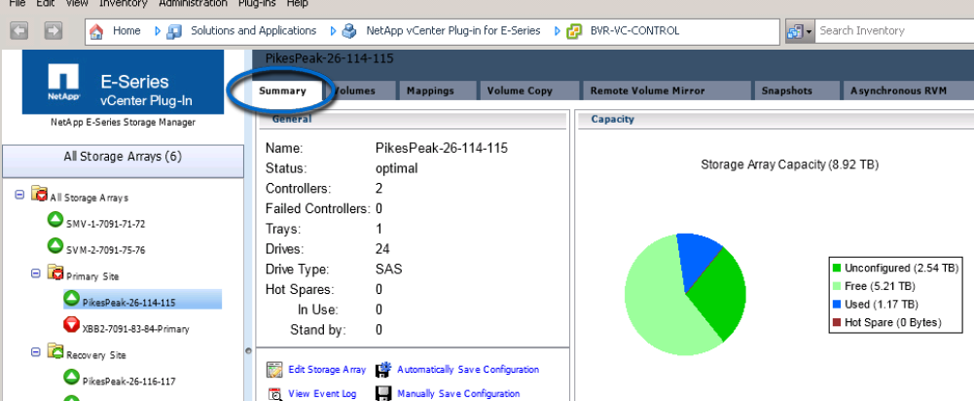
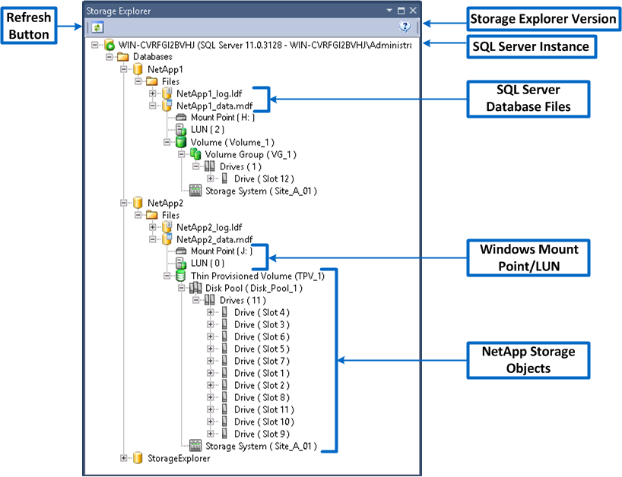
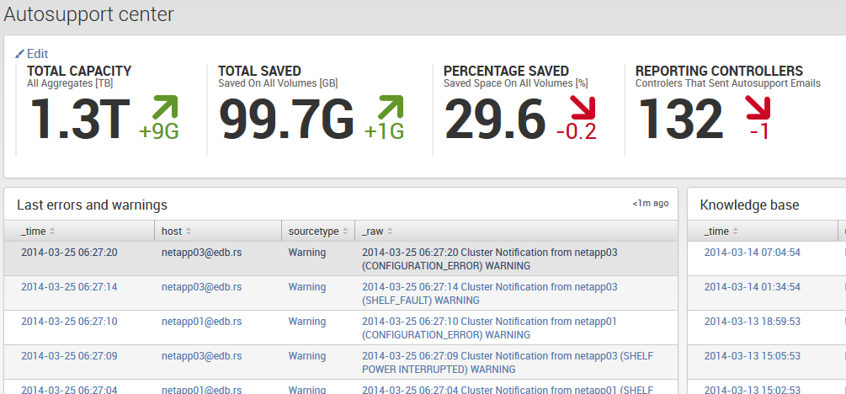
Nadzor
vCenter Plugin
Microsoft SCOM
…
…
…
Splunk !!!
Notes:
22

Slide 23

Q&A
Notes:
23

Slide 24

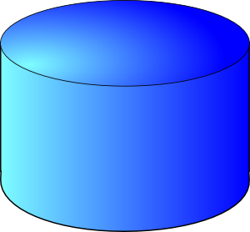
Kaj pa v praksi?
Oracle IO load generator (Orion)
  Simple
  Normal
  Advanced
Intel server
Oracle LINUX
4x 500GB LUN (ext3)
Notes:
24

Slide 25
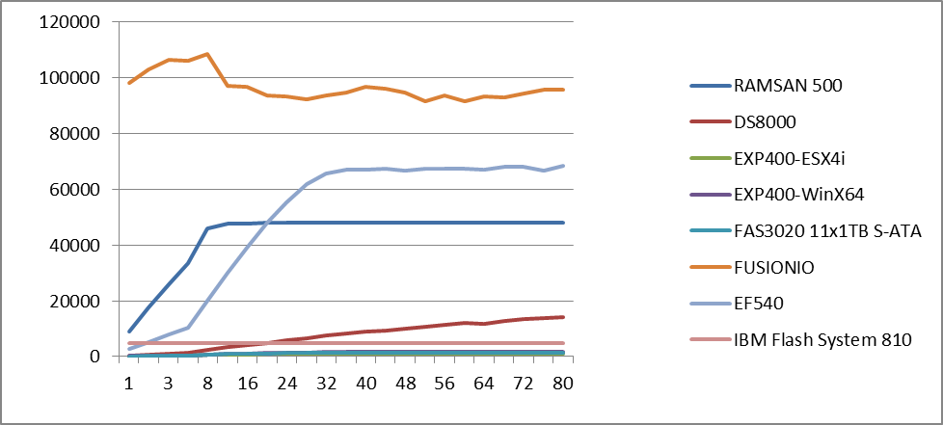
Rezultati IOPS
Notes:
25

Slide 26
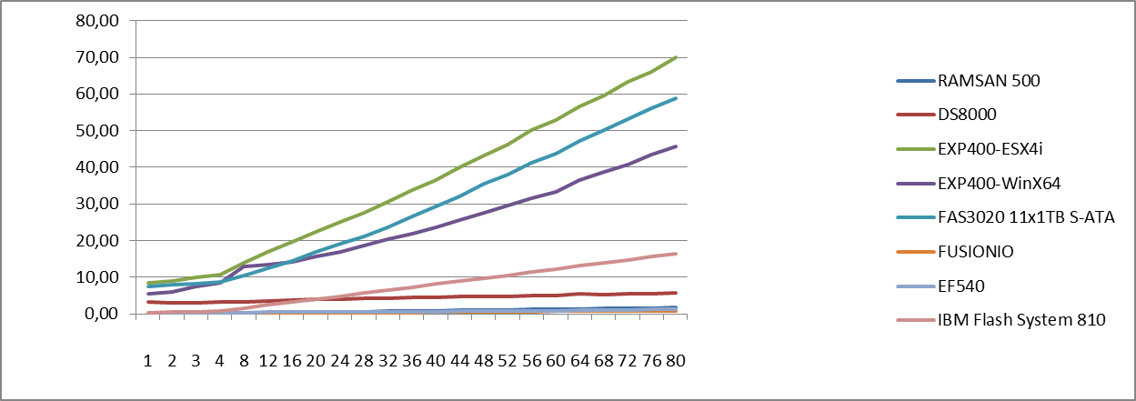
Rezultati Latency
Notes:
26

Slide 27
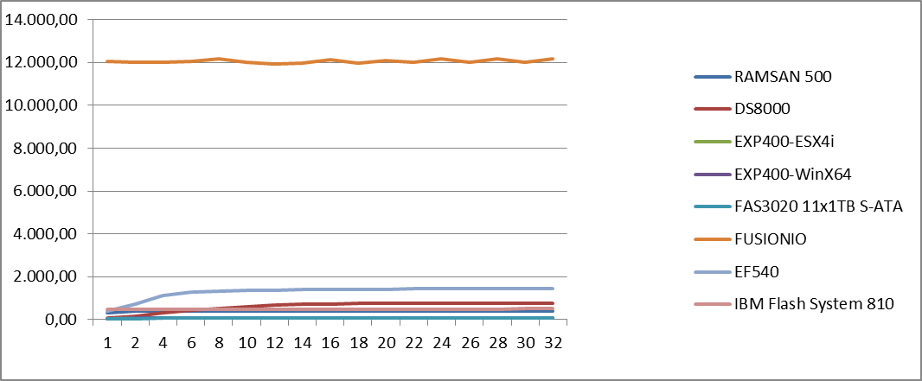
Rezultati MBPS
Notes:
27

